Slide 1
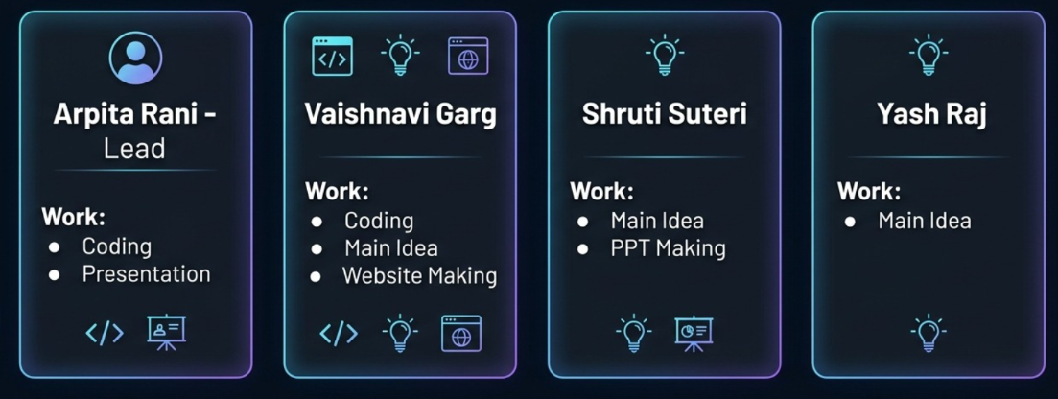
HACKATHON • PROJECT PRESENTATION
EMOTITUNE
Emotion-Based Music Recommendation
Your mood. Your music. Your vibe.
A mood-aware music discovery prototype that lets users choose how they share their mood, personalize song searches, and open their preferred streaming platform.
TEAM INTRODUCTION / 04 MEMBERS
TEAM LEADER
MEMBER 01
MEMBER 02
VAISHNAVI GARG
ERP ID: 1000031248
SHRUTI SUTERI
ERP ID: 1000031138
01/06

Slide 2
01 / SOLUTION DESIGN
Approach & Problem Statement
A guided workflow reduces the effort of finding music that fits the listener’s current mood.
PROBLEM
OUR APPROACH
PERSONALIZATION
Users often spend time searching across platforms for music that fits how they feel.
Offer two mood-input paths: camera-based facial-expression estimation or manual mood selection.
Combine mood, preferred language, music style and streaming platform into a search query.
USER-CENTRED DESIGN
• Camera use is optional; users can select their mood themselves.
• Users can adjust the suggested mood and choose a preferred genre.
• The result opens a search on YouTube, YouTube Music or Spotify.
MOOD
LANGUAGE
GENRE
PLATFORM
02/06

Slide 3
02 / IMPLEMENTATION
Technology Stack
The supplied prototype uses browser-based front-end code and a facial-expression library.
HTML5
CSS3
JAVASCRIPT
Defines the multi-step interface, buttons, mood choices, language selector and result panel.
Creates the dark gradient theme, responsive cards, button states, transitions and progress bar.
Controls navigation, state, input validation, camera flow and search-link generation.
face-api.js
MEDIADEVICES API
MUSIC PLATFORMS
Uses Tiny Face Detector and Face Expression Net to estimate facial expressions in camera mode.
getUserMedia() requests camera access from the browser; the user must grant permission.
Builds search URLs for YouTube, YouTube Music and Spotify; the selected service opens in a new tab.
03/06

Slide 4
03 / SYSTEM WORKFLOW
System Flowchart
Decision flow from user input to the selected music platform.
Camera: estimate
expression
START
Choose mood
input method
Choose
language
Choose
music style
Manual: select
mood
Choose
platform
Open music search
in new tab
Generate platform
search URL
Build query:
mood + language + genre
04/06

Slide 5
04 / WORKING PROTOTYPE
Prototype: What We Built
EmotiTune is a step-by-step website with clear choices and a personalized search result.
🎧 EmotiTune
PROTOTYPE FEATURES
YOUR MOOD. YOUR MUSIC. YOUR VIBE.
• 7-step interface with progress indicator.
• Optional camera analysis or manual mood input.
• 8 mood choices and 11 language options.
• Genres include Pop, Lo-fi, Relaxing, Workout and Classical.
• Platform selection: YouTube, YouTube Music or Spotify.
• Summary screen and “Open My Music” action.
How would you like to share your mood?
📸 Use Camera
💭 Answer Questions
Choose a mood
😊 Happy
😔 Sad
😌 Relaxed
⚡ Energetic
Next: language → genre → platform → results
DEMO PATH
Start → mood → language → genre → platform → results → open music
05/06

Slide 6
05 / SOURCES & NEXT STEPS
References & Future Scope
Technical references for the libraries and browser features used in the prototype.
OpenAI ChatGPT — AI assistant for code architecture and logic debugging.
Google Gemini — AI research, ideation, and architectural planning.
Google Chrome — Primary browser environment and developer tools for testing and debugging.
face-api.js — Facial expression and face detection library.
Music Streaming Platforms — YouTube , YouTube Music , and Spotify.
REFERENCES
FUTURE SCOPE
• Add a Python backend if required for user profiles or recommendation logic.
• Improve recommendations using feedback and listening preferences.
• Integrate official music APIs where permitted by platform terms.
• Test camera permissions, mobile layout and accessibility.
• Make privacy choices clear and let users edit detected mood.
THANK YOU / EMOTITUNE
ARPITA RANI • VAISHNAVI GARG • SHRUTI SUTERI • YASH RAJ
06/06

